Slide 1
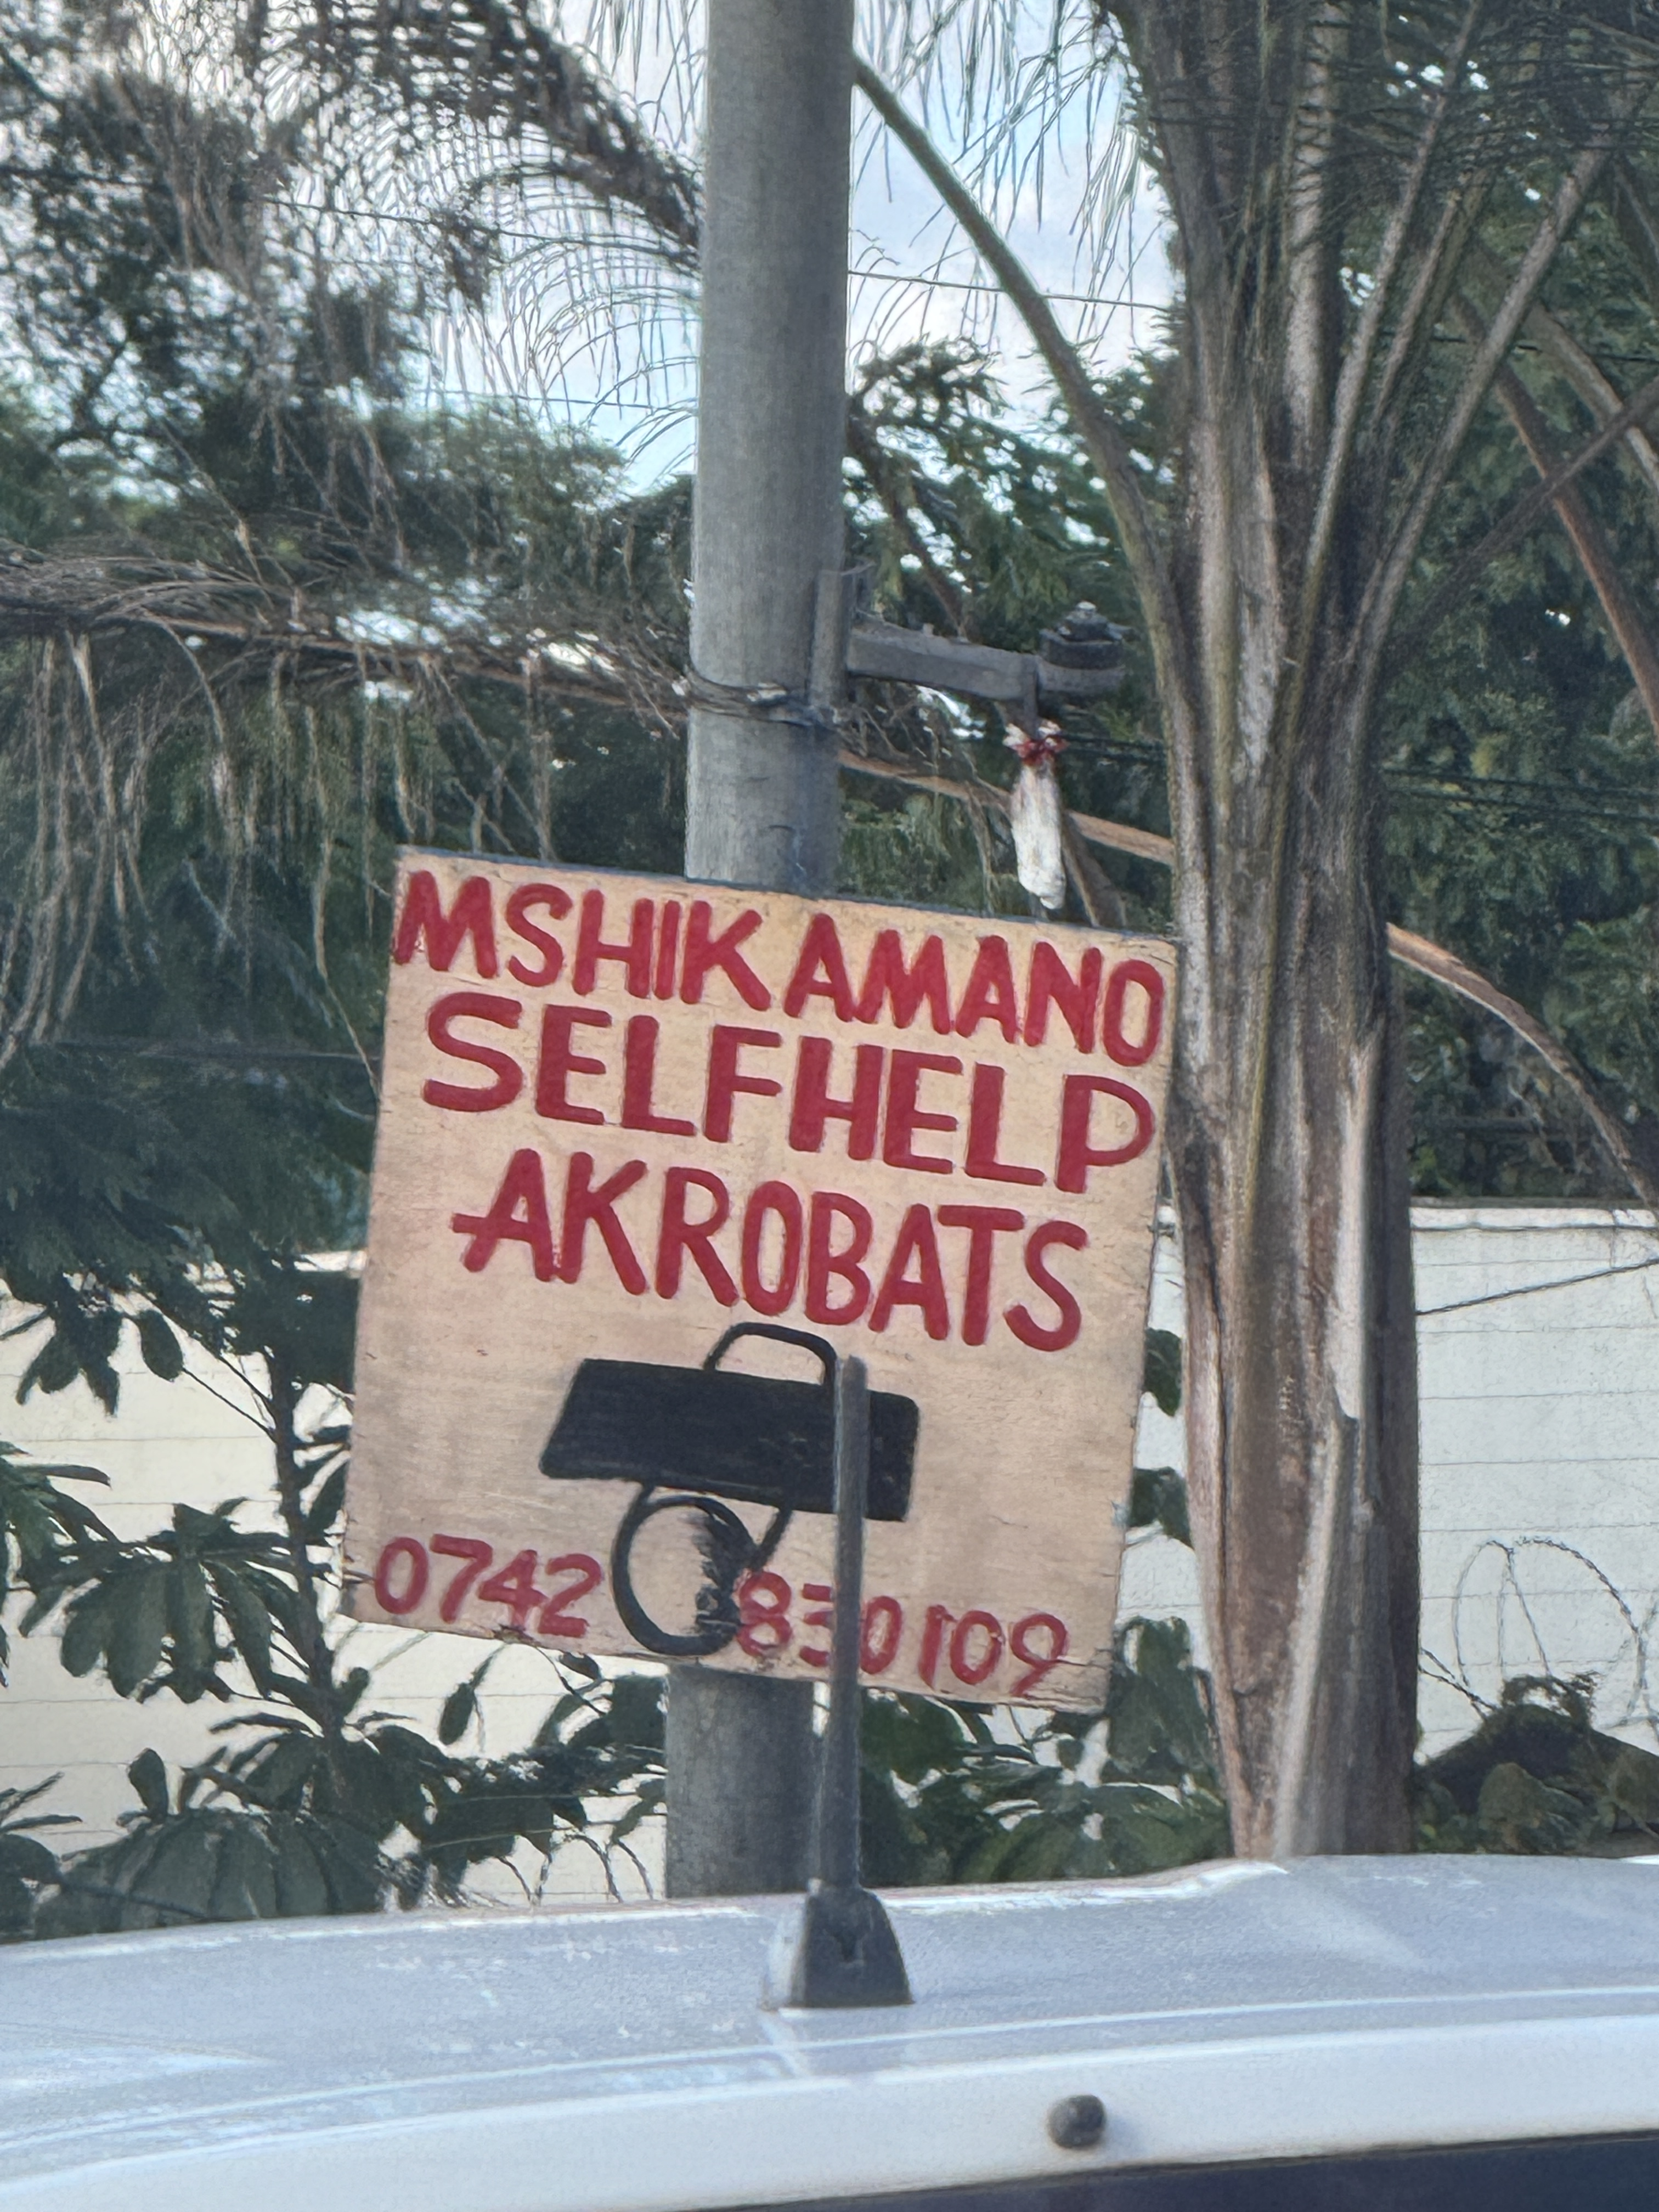
PANHANDLING
AT URBAN INTERSECTIONS
The Nairobi Lens
Douglas Ragan
Managing Director, Turning Tides · PhD Candidate, Carleton University
Former Programme Officer, UN-Habitat
NAIROBI, KENYA

Slide 2

ME
30 years in children & youth development
From Canadian NGO practice to global programme management I have placed myself at the intersection of youth agency, urban space, and structural exclusion.
15+ years in Nairobi's informal settlements
Engagement in Mlango Kubwa Village in the Mathare, Informal Settlement — initially as a practitioner with UN-Habitat, later as a doctoral researcher. Built on relationships, not research access alone.
UN-Habitat, Head of Youth Unit
Established One Stop Youth Centres in Mlango Kubwa, Mathare and across East Africa. Managed the Urban Youth Fund. Coordinated youth-led peacebuilding in Somalia, Rwanda, and Kenya.
Turning Tides | turningtides.today
PhD Candidate · Carleton University
PhD research grounded in Mathare
'Made in Mathare' (Carleton, 2026): how youth subject positions — masafara, watu wa mtaa, the hustler — are co-constituted through youth organizations. 18 years ethnographic presence in Mlango Kubwa.
Ragan, D. (2013). Cities of Youth, Cities of Prosperity. UN-Habitat; Ragan, D. (2025). Made in Mathare [Doctoral Dissertation Proposal, Carleton University]

Slide 3
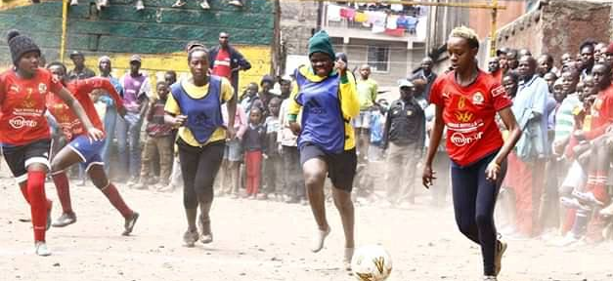
NAIROBI
SCALE
STRUCTURAL ROOTS
THE “HUSTLE” ECONOMY
Nairobi: 4.4M residents. 60–80% in informal settlements.
Mathare Informal Settmenet alone: 300,000+ in 3 km².
Street presence in Nairobi is inseparable from colonial-era displacement, anti-urbanism, and deliberate state abandonment.
Begging is ONE position in a wide spectrum of informal survival: hawking, waste collection, bodaboda riding, and music.
The intersection is not a last resort — it is a calculated territory.
KNBS (2019). Kenya Population and Housing Census; Ragan, D. (2021). HabTalk Podcast, UN-Habitat; Ng'weno, B. (2025). No Place Like Home in a New City. UC Press

Slide 4
WHO IS PANHANDLING IN NAIROBI — AND WHY?
67%
80%
Three overlapping profiles:
The Structurally Excluded
Youth unemployment rate
(ages 15–34, Kenya)
Urban youth jobs are
informal / no social security
Youth from the informal settlements are displaced by colonial land laws, absent welfare systems, persistent police criminalization.
The Trafficked & Exploited
15,337
Ksh 50–100 /.50 – $1.00
Organized cartels deploy persons with disabilities . Handlers collect earnings - the panhandler often earns nothing.
Street-connected individuals
in Nairobi (KNBS Census)
Daily earnings of
street-connected youth
The Hustler
Voluntary, strategic positioning at high-traffic intersections. Begging is one node in a multi-income informal economy — not a permanent identity.
FKE Kenya (n.d.). Youth Employment Policy Brief; World Bank (2024). Kenya Youth Employment; Nation Africa (2024, Mar 24). When begging becomes lucrative hustle; PMC/Moi University (2020). Street-connected children. PMC7455900

Slide 5
THE SPATIAL LOGIC OF NAIROBI'S INTERSECTIONS
NAIROBI'S HIGH-ACTIVITY CORRIDORS
Captive audiences at red lights
Nairobi's chronic gridlock - 2-hour peak commutes - creates extended windows of eye contact and social pressure between drivers and panhandlers.
Uhuru Highway / Waiyaki Way →
Proximity to informal settlements
Nyayo
Stadium
Globe
Roundabout
Haile
Selassie
Mathare informal settlement is 3.7 km from the CBD. Kibera informal settlement borders Ngong Road. Intersections are the commuter seam between wealth corridors and settlement margins.
Mombasa Road →
Territorial logic
Mombasa
Rd Jct
Westlands
Thieme (2025) documents youth 'redrawing the map' — intersections are claimed, defended, and organized. This is the hustler geography at work.
Ngong Road →
No pedestrian infrastructure
Most Nairobi footpaths were demolished for the recently built Expressway. Without infrastructure, intersections become the only legible public space.
Nation Africa (2025, Oct 27). Gridlocked capital. Daily Nation; ITDP Africa (2023). Reimagining the Nairobi Expressway; Thieme, T. (2025). Hustle Urbanism. U of Minnesota Press

Slide 6
STRUCTURAL DRIVERS — NOT A PROBLEM TO MANAGE, A HISTORY TO RECKON WITH
1950s
Colonial checkpoints at entry points to the city.
Who belongs in Nairobi was decided by race, not need. Mathare formed as squatter settlement for those turned away.
1970s
Informal economy expansion
Traders, hawkers, cobblers fill gaps the state never filled. Urban survival becomes self-organized from the start.
1990s
Structural adjustment / State retreat
IMF/World Bank austerity dismantles social services. Youth unemployment rises. Street presence expands.
2003
Street Families Rehabilitation Trust Fund
Government establishes fund — but 250,000–300,000 people remain on streets. Fund declared 'largely inadequate.'
2024–25
Cartels & organized begging
Nairobi County targets syndicates. But enforcement without housing or income support simply relocates, not resolves.
Ng'weno, B. (2025). No Place Like Home in a New City. UC Press; Kimari, W. (2017). Doctoral Dissertation, York University; Wananchi Reporter (2024, May 20). Mlango Kubwa estate. Citizen Digital

Slide 7
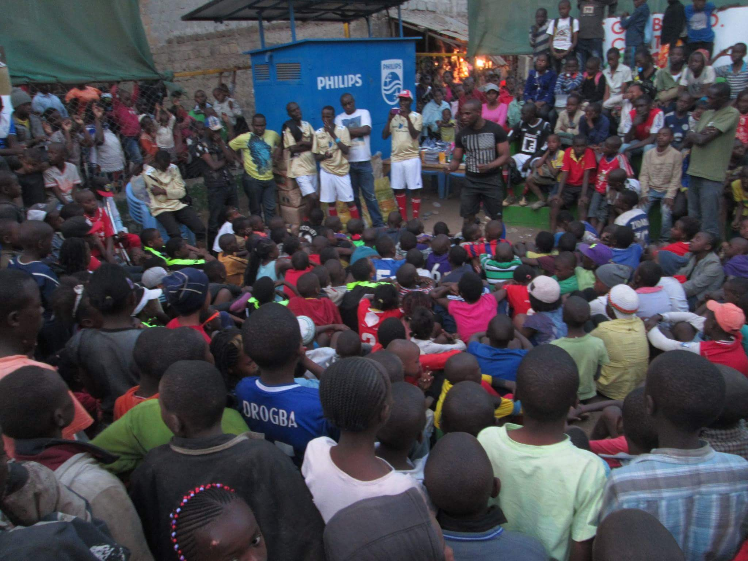
WHAT WOULD THEY RATHER BE DOING?
“
The hustle spectrum in Mathare:
People didn't have any culture. People are just in the community having nothing to do. And most of them, they have gifts, they have gifts of the arts, but they were just wasting it away.
Music & arts
Mathare Empire — concerts fill the vacancy that crime used to occupy
Waste collection
Thieme (2025): hustle as livelihood strategy, not last resort
Hawking & vending
At intersections — legal, visible, contested
— Kid Wonder,, October 2025
Bodaboda riding
Motorcycle taxis — regulated, insecure, but chosen
Ragan, D. (2025). Made in Mathare [Doctoral Dissertation, Carleton University]; Thieme, T. (2025). Hustle Urbanism. U of Minnesota Press; Thieme, T. (2013). Journal of Eastern African Studies, 7(3)
Begging / solicitation
For many: ONE node in a multi-source income strategy, not sole income

Slide 8
PUBLIC GIVING DYNAMICS — WHO GIVES, AND WHY?
Ubuntu & communal obligation
The complexity of giving
African giving is rooted in Ubuntu — the moral obligation to assist others. Research from KwaZulu-Natal (Maphumulo, 2015) finds:
• Proximity drives giving — most help occurs within trusted networks
• Ubuntu's influence is waning under economic pressure, but remains a moral reference
• Giving in traffic is a social transaction
Giving is not the problem
Daily Nation (2024) reports that Nairobi's 'generosity' is specifically exploited by cartels — who intercept the money. Donors cannot tell the difference.
Organised exploitation distorts dynamics
Handlers deploy people with disabilities, collect earnings. The cartel earns; the person on the street may earn nothing.
Giving sustains AND traps
Giving ensures a basic income but entrenches the intersection as a viable territory. The policy challenge: how to redirect giving to structural support.
In Nairobi, the Kenyan motorist who gives
at a red light is enacting Ubuntu,
not endorsing a system.
Public embarrassment vs. moral duty
Nairobi motorists face daily social pressure. Refusing to give carries social cost — especially within Ubuntu norms.
Maphumulo Community Study (2015). How and why poor people help each other. Academia.edu; Nation Africa (2024). When begging becomes lucrative hustle; The Star (2025, Aug 10). Nairobi decries surge in beggars; Kenyans.co.ke (2025)

Slide 9
WHAT HAS NAIROBI TRIED? POLICY LESSONS FROM THE GLOBAL SOUTH
FAILED
INADEQUATE
PROMISING
ONGOING
EVIDENCE-BASED
Roundups & Repatriation
Street Families Trust Fund (2003)
Mathare / Slum Soccer Model
2025 Cartel Surveillance Drive
Reintegration + Community (Meru, 2023)
County officials remove beggars, take them to court, seek repatriation orders. Cartels bring them back within days. Authorities describe themselves as 'largely powerless.'
Government fund established to rehabilitate street families. Street population has grown since. Policy document described as 'largely inadequate due to institutional weaknesses.'
MECYG, Mathare Empire youth-built infrastructure that provides recognition, status, and income alternatives - without requiring the state. Sustained for 25+ years.
Nairobi County targeting syndicates deploying disabled persons.
Public awareness campaign. No housing or income component — structural gap remains.
Flourishing Community model: rescue + reintegration + family empowerment.
Nation Africa (2024); Kenyans.co.ke (2025); The Star (2025, Aug 10); PMC (2023). Flourishing Community model. PMC10482225; Amoah & Nyamekye (2022). Participatory Strategies, Mathare Sub-County

Slide 10
WHAT CAN WE LEARN FROM NAIROBI
01
02
03
04
The intersection is a diagnosis, not a pathology
Enforcement without income is just relocation
The hustler is not waiting for rescue
Giving is a social contract, not a problem to stop
When people appear at intersections, the intersection is telling you something about housing, income, and belonging — not about the character of the individual.
Every roundup in Nairobi has failed. Cartels bring their workers back within 24 hours.
Youth in Mathare built the One Stop, planted trees, organized concerts, and contested their stigma — without waiting for state permission.
Ubuntu-shaped giving in Nairobi is a communal act. Redirecting that energy toward structural support requires honouring it, not criminalizing it.
05
'For that day we have saved you. For that day you didn't have to die.' Mathare Empire's concert is a success by any measure — one that no rehabilitation report will ever capture.’ ~ Kid Wonder
Success looks different from the inside
Ragan (2025) Dissertation; Ng'weno (2025); Thieme (2025); Kimari (2017); Kid Wonder interview (2025)

Slide 11
THE QUESTION KID WONDER ASKED IN 2021
IS STILL THE RIGHT QUESTION IN 2026
“When you google Mathare — what do you want to see?”
The person at the Ottawa intersection and the person at Waiyaki Way and Uhuru Highway are asking
the same thing: to be seen, to be heard, to be felt, to be known.
What differs is the structural room they have to answer that need differently.
Douglas Ragan | Doctoral Researcher, Mathare / UN-Habitat | dragan@uottawa.ca
NAIROBI ↔ OTTAWA

Slide 12
RESOURCES AND FOOTNOTES
1. Abebe, T. (2019). Reconceptualising children's agency as continuum and interdependence. Social Sciences, 8(3).
2. Kimari, W. (2017). 'Nai-rob-me,' 'Nai-beg-me,' 'Nai-shanty': Historicizing space-subjectivity connections in Nairobi. York University [Doctoral Dissertation].
3. Madsen, M. L. (2025). Here in Mathare, it's a crime to be a youth: Citizenship, participation and violence at the urban margins. Aalborg University.
4. Ng'weno, B. (2025). No Place Like Home in a New City: Anti-Urbanism and Life in Nairobi. University of California Press.
5. Thieme, T. (2025). Hustle Urbanism: Making Life Work in Nairobi. University of Minnesota Press.
6. Thieme, T. (2013). The 'hustle’ amsongst youth entrepreneurs in Mathare's informal waste economy. Journal of Eastern African Studies, 7(3).
7. PMC / Moi University (2020). Characterizing street-connected children and youth's social and health inequities in Kenya. NCB/PMC 7455900.
8. PMC (2023). Enabling structural resilience of street-involved children and youth in Kenya: Flourishing Community model. PMC 10482225.
1. FKE Kenya. Youth Employment Policy Brief — Kenya youth unemployment rate (67%, ages 15–34). fke-kenya.org.
2. Daily Nation (2024, March 24). When begging becomes lucrative 'hustle' on Nairobi street.
3. Kenyans.co.ke (2025). Nairobi County Targets Syndicates Using Street Children and Disabled for Begging.
4. The Star Kenya (2025, August 10). Nairobi decries surge in beggars faking disabilities.
5. ITDP Africa (2023). Reimagining the Nairobi Expressway as a Green Corridor. itdp.org.
6. KNBS (2019). Kenya Population and Housing Census: Volume I. Kenya National Bureau of Statistics.
7. Ragan, D. (2025). Mathare Reimagined: The Journey of Kid Wonder [Doctoral Dissertation Introduction]. Unpublished.

